Slide 1


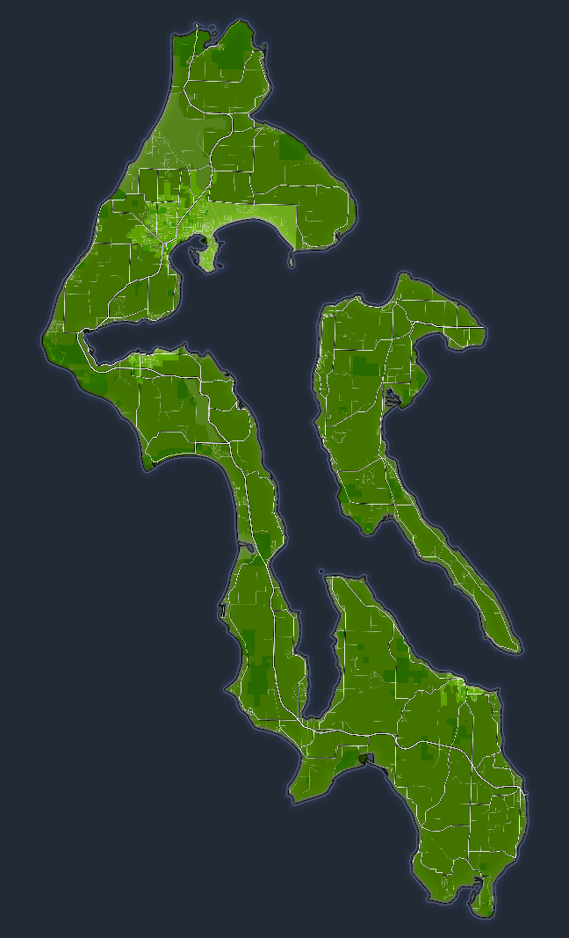
Proposed Testing Protocol for Water & Sewer Franchises
September 17, 2025

Slide 2
Testing Protocol
Current Requirements: [267 of 277 total franchises = water & sewer]
No interference with County road travel
Obtain Permits, when required
24 hour / 7 days emergency response
Maintain necessary insurances
Comply with Federal & State law
Proposed Additional Testing Protocol Requirements
Valves installed to allow for testing
Pressure tests for integrity of water lines
Dye Tests to identify potential leakage of sewer lines
Timeline:
2025 – notify all franchise holders of requirement and timeline
2026 – franchise holders plan and budget for requirement
2027 – franchise holders contract / install necessary system enhancements
2028 – additional required testing protocol performed prior to franchise renewals
** Require “new” franchises received after August 2025 to certify system prior to issuing franchise
** All testing / certification performed by independent certified testing agent

Slide 3
Edits Made to the Franchise Template
Removed additional 10-year extension verbiage
Added **System Non-Compliant** header option
Added section 7) System Cyclic Certification Testing –
a) Water and septic systems shall be tested and copy of certifications provided to Public
Works and Health Departments b) Fire hydrant annual inspection certifications provide to local fire department and
Public Works c) Prior to issuance of renewal or transfer certifications must be up-to-date: 1. Must meet the goal of 3 year less than 10% leakage 2. 2-hour hydrostatic test 1 month prior to submittal 3. Sewage system dye tested and certified 4. 10-year renewal term for compliant systems, 2-year renewal term for septic
systems that are discovered to leak d) Renewal fee doubled for non-compliant systems
Franchises that are ready to go to Public Hearing: ~32
Franchises that still need application submittal for Renewal/Transfer: ~34
2026 franchise expirations, applications not yet sent: ~25

Slide 4
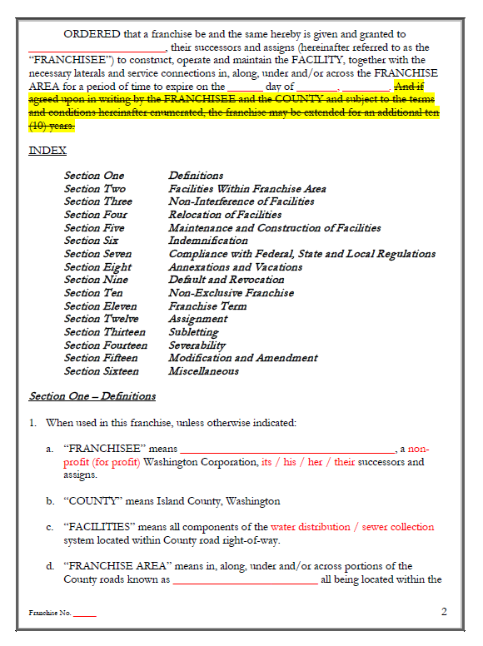
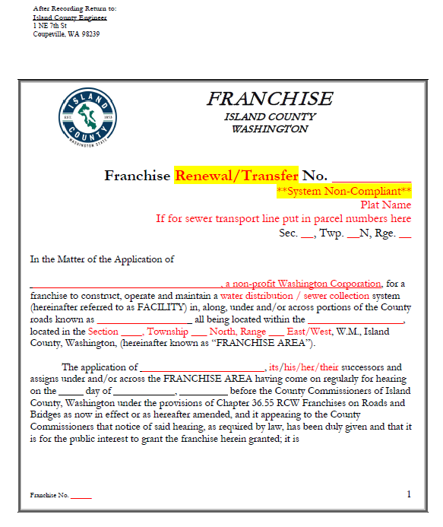

Slide 5
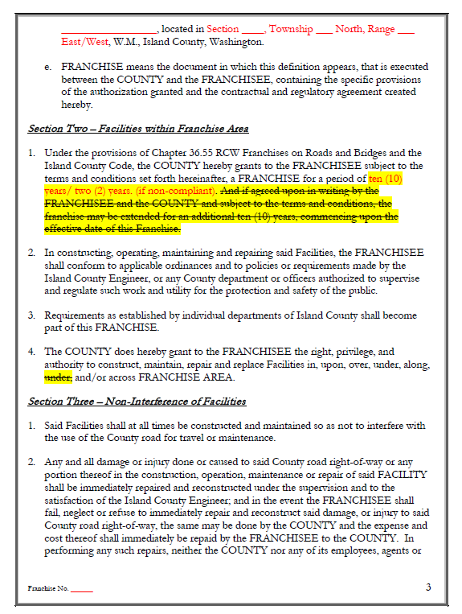
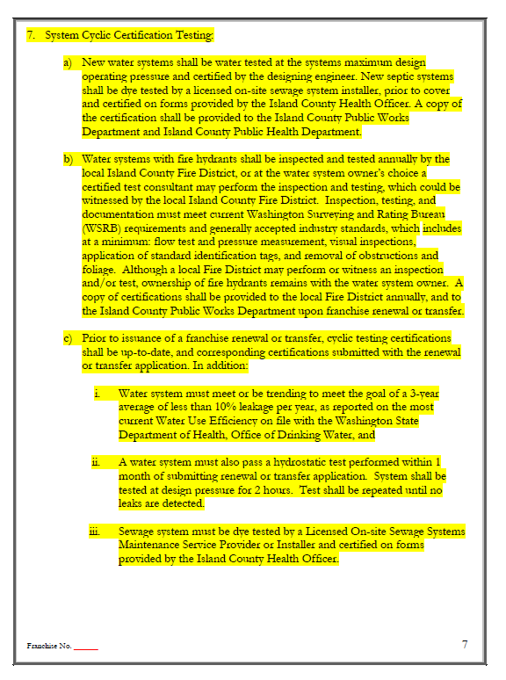

Slide 6
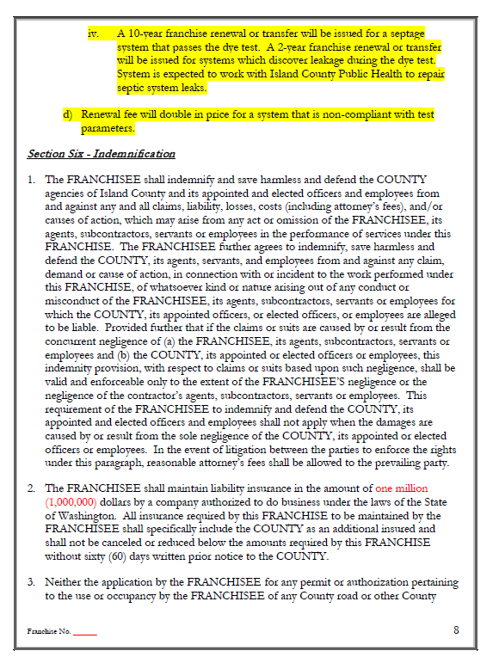
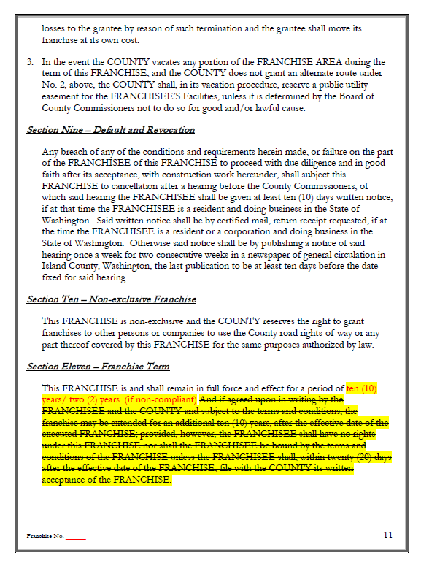

Slide 7
Questions

