Slide 1

2025 Comprehensive Plan Periodic update
Housing Element Goals and Policies review
March 13 & 20, 2024

Slide 2

Purpose of Session
Review the 2016 Housing Element Goals and Policies.
Share feedback from public, county departments, advisory boards, and GMA required updates.
Gather Board feedback on where changes are needed.

Slide 3
Housing Goal 1
Encourage preservation of existing housing stock capacity, subsidized affordable housing units, and the character of existing communities.

Slide 4
Housing Goal 1 and Policies 1.1 to 1.8 Feedback
Consider removing “Character” from the goal statement due to equity concerns.
Streamline the permitting process, look at overlapping processes, and timeline barriers. Remove guest cottages from list of examples. [H 1.2]
Reword to promote upgrading existing housing stock, for all income levels, to make more energy efficient in response to climate change. Add reduce dependence on natural gas. [H 1.4]
Pursue offerings from federal funding sources such as the PRICE program, “Preservation and Reinvestment Initiative for Community Enhancement” to preserve existing manufactured housing, including repair, rehabilitation, and replacement of existing homes; infrastructure improvements; and planning activities. [H 1.5]
Change “monitor” to “document”; and consider policy changes to address vacation rentals. Monitor impact on septic and drinking water infrastructure to determine sustainability of vacation rentals, with particular attention near critical areas, shorelines, and critical aquifer recharge areas. [H 1.7]
Design communities with housing options that create access to social drivers of health.
Systematically consider groundwater and sewage infrastructure and incentivize innovative solutions and technologies to create supportive housing.
Strengthen partnerships with community outreach workers and community-based organizations to extend access to home repair and home health resources for historically under-reached communities.

Slide 5
Housing Goal 2
Promote the development of different housing types, such as rentals and manufactured homes, to meet the needs of all demographic segments of the population, housing tenure choices, and income levels. Provide for these housing types in appropriate locations where infrastructure, public transit, and community services are readily accessible, planned in the near future, or are included as part of a new fully-contained community as described in RCW 36.70A.350.

Slide 6
Housing Goal 2 and Policies 2.1 to 2.14 Feedback
Consider revising goal or adding a new goal about accommodating income levels.
Remove “encourage” throughout policies and make stronger to comply with HB 1220.
Utilize 1590 funds in a manner that demonstrates local commitment and support for affordable housing development (e.g., providing local match required by most federal and state funding sources). [H 2.1]
Combine policies H 2.3 and H 2.4 to find creative multi-family solutions in all rural residential zones. Consider adding Community Land Trust concept to the list. [H 2.4]
Incentivize cluster housing and Planned Residential Developments by reducing impact fees, permitting costs, or providing density bonuses for affordable units. Add reference PRD policies in Land Use Element. [H 2.5]
Adopt zoning code provision to encourage and facilitate cottage housing development. Allow existing manufactured home parks to expand if infrastructure is available. Reduce regulatory requirements for ADUs to encourage their construction. [H 2.6]
Consider strengthening H 2.8 to address the mandate to plan for and accommodate permanent supportive housing and emergency shelter.
Consider rephrasing H 2.10 and 2.11 to be consistent with new mandates and remove unnecessary housing types.
CONTINUED

Slide 7
CONTINUED: Housing Goal 2 and Policies 2.1 to 2.14 Feedback
Complete comprehensive study of wastewater infrastructure and opportunities in Island County; use study findings to support increased funding and legislation for septic infrastructure that supports housing opportunities.
Incentivize Large Onsite Septic Systems (LOSS), Step Systems, and technologies that support density and supportive/workforce housing across different zones based on comprehensive study.
Strengthen interdepartmental coordination of software permitting utilization and streamline application requirements and use of a centralized site plan.
Continue to support the active affordable housing projects. Work to incentivize supportive housing.
Explore and support options for employer-assisted workforce housing. Explore options to identify housing for seasonal workers. Evaluate options to encourage the development of long-term ADU and DADUs. Review regulations and restrictions for RVs and tiny homes as supportive housing options.
Strengthen policy H 2.11 further to address permitting cost and time. Some permitting prescriptions for smaller multi-unit dwellings are not conducive to permitting that favors single family developments.
RV parks are often the only affordable option. Consider time limits, how many are allowed per acre, incentives, and higher density with septic/water hookups. [H 2.13]
Consider moving/addressing policy H 2.14 under the Land Use Element.

Slide 8
Housing Goal 3
Promote fair access to housing and shelter for all persons.

Slide 9
Housing Goal 3 and Policies 3.1 to 3.6 Feedback
GMA requires identifying policies that result in racially disparate impacts, establishing policies to begin to undo impacts, and establish anti displacement policies RCW 36.70A.070.2 e, f, and g.
Strengthen language: “identifying and ensuring”. Incentivize with density bonuses; consider not allowing one story commercial buildings without housing above. Consider using offsets to load shift in certain areas.
Consider committing funding as another approach.
Consider more emphasis or advocacy to support seniors with limited income and disabilities. [H 3.1]
Consider strategies to better understand and address race, income, gender, and ethnic disparities in housing quality and home health needs. Consider developing communities of practice with epidemiologists, housing professionals, planners, and community leaders.
Promote cultural competency awareness for landlords through outreach and education.
Consider emergency preparedness in housing design and neighborhood planning across housing types and zoning, collaborating with ICOM, DEM, Public Works, Public Health, and other stakeholders.
Actively build trusted relationships with diverse communities to raise awareness of boards and committees and strengthen inclusive approaches for engagement from under-represented community members, working with trusted leaders, community health and outreach workers, and community-based organizations reaching marginalized populations.

Slide 10
Housing Goal 4
Promote policies that facilitate the reduction in the share of cost burdened households by increasing the supply of subsidized housing.

Slide 11
Housing Goal 4 and Policies 4.1 to 4.8 Feedback
Reword policy 4.1 to address all income levels.
County doesn’t own or operation any housing, the County partners with HUD to provide services. Policies 4.3 to 4.8 are relevant to the County’s role. Policies 4.1 and 4.2 need to be reworded.
Consider underutilized spaces for housing (e.g., school campuses, parking lots, Port of South Whidbey fairgrounds) through zoning code amendments. [H 4.4.]
Specify incentives in H 4.6.
Fully utilize all available tools, resources, and funding streams available for affordable housing at the local, state, and federal level. Explore options to direct funds towards infrastructure and programs that support affordable housing development.
Continue to support the active affordable housing projects (Swanton Road, Camas Flats, Harbor Inn, 2nd & DeBruyn, Habitat for Humanity).
Work to incentivize supportive housing across zoning. Explore and support options for employer-assisted workforce housing. Explore options to identify housing for seasonal workers. Evaluate options to encourage the development of long-term ADU and DADUs.
Continue to develop stronger relationships with contractors and builders through events such as the Builders Listening Session.

Slide 12
Housing Goal 5
Collaborate with other jurisdictions and housing organizations to address county-wide housing issues.
Housing Goal 5 and Policies 5.1 to 5.7 Feedback
Consider a Transfer of Development Rights (TDR) program countywide and not limited to the NMUGA in Freeland.
Remove ”Opportunity Council” as there are many other housing groups to work with that would all be included in the non-profit section. [H 5.3]

Slide 13
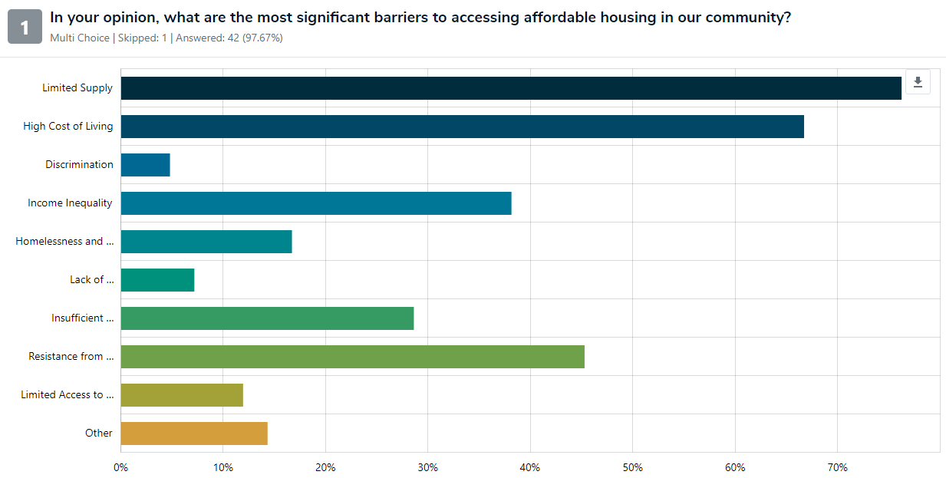
Public Feedback
Homelessness and Housing Insecurity
Lack of Transportation
Insufficient Supportive Services
Resistance from Community
Limited access to credit and financing

Slide 14
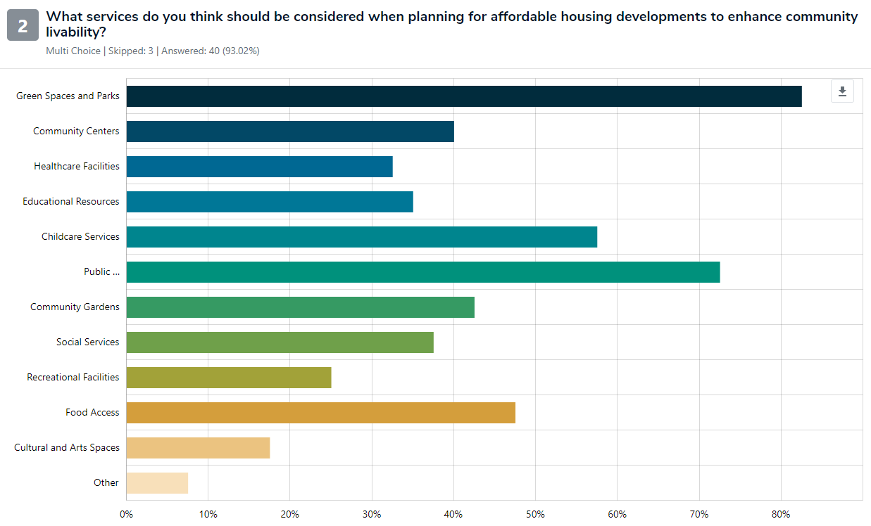
Public Feedback 2
Public Transportation Access

Slide 15
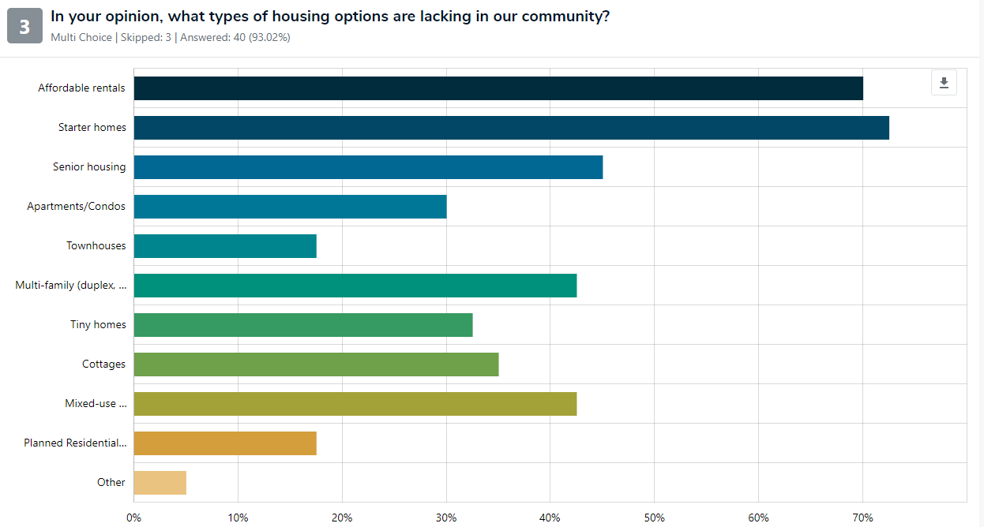
Public Feedback 3

Slide 16
Summary of Public Input Received via Online Surveys Related to Housing
Consider denser housing in already developed areas.
Consider restricting short-term rentals to increase availability of affordable housing.
Consider taxing owners of second homes to encourage them to convert to long term rentals.
Consider building affordable living options for local people and service staff required for local businesses.
Consider more flexibility for alternative housing options including ADUs and tiny homes.
Consider stronger incentives for affordable, workforce, and multi-family housing.

Slide 17
Feedback / questions
Visit our public engagement website:
www.islandcounty2045.com
Sign up to receive Comp Plan emails:
CompPlan@islandcountywa.gov

