Slide 1
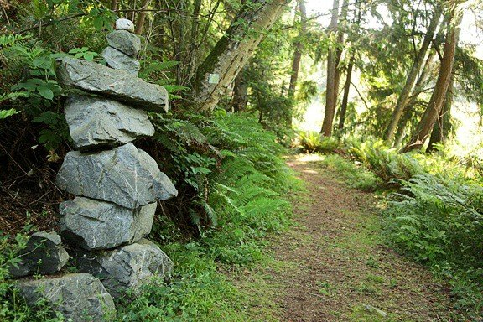
Element 7, Parks & Recreation, 2025 Island County Comprehensive Plan
December 2024

Slide 2
Agenda
1. Results of online survey
2. Park and recreation demand projections
3. Work in progress
4. Questions

Slide 3
Online survey results Residence
Respondent resident location | Percent
Oak Harbor | 12%
Coupeville | 18%
Langley | 15%
Freeland | 13%
Clinton | 13%
Other Whidbey Island | 4%
Camano Island | 22%
Outside Island County | 3%

Slide 4
Years of residency in Island County
Years of residence in Island County | Percent
0-2 | 4%
2-5 | 13%
6-10 | 21%
11-15 | 13%
16-20 | 10%
20+ | 38%

Slide 5
Number of people in household
Number household members | Average
Total household members | 2.27
Household members under age 18 | 0.29
Household members aged 19-64 | 1.09
Household members over age 65+ | 1.26
Age group
Age groups of survey respondent | Percent
10-14 | 0%
15-18 | 0%
19-25 | 0%
26-40 | 8%
41-55 | 13%
56-65 | 19%
65+ | 61%

Slide 6
Language spoken at home
Languages spoken at home | Percent
English | 97%
Spanish | 0%
Russian | 0%
Vietnamese | 0%
Chinese | 0%
Japanese | 1%
Korean | 0%
Pacific Island | 0%
Other | 2%

Slide 7
Gender
Gender | Percent
Male | 36%
Female | 61%
Other | 0%
Prefer not to answer | 4%
Current housing situation
Housing tenure | Percent
Own | 95%
Rent | 5%

Slide 8
Recreation activities engaged in by survey respondents
Recreation activity engaged in by survey respondents in Island County | Not at all | Some | A lot
Sightsee - historical, cultural site and facility | 7% | 61% | 33%
Observe wildlife – plants, birds, animals, marine | 3% | 28% | 70%
Fish – from a boat, dock, shoreline | 60% | 26% | 14%
Beachcomb, beach walk, shellfish | 6% | 37% | 57%
Kayak, canoe, other hand-carry craft | 41% | 39% | 20%
Power boat | 77% | 15% | 9%
Walk, hike, jog on trails | 3% | 23% | 74%
Bike on trails, roads | 50% | 33% | 17%
E-bike on trails, roads | 80% | 13% | 7%
Horseback ride on trails | 90% | 6% | 4%
Picnic, BBQ, or cookout in a park | 38% | 55% | 7%
Playground | 57% | 31% | 11%
Skateboard, pump track, BMX | 90% | 8% | 3%
Sports courts - basketball, pickleball, tennis outdoors | 63% | 20% | 17%
Athletics – soccer, baseball, lacrosse, football | 76% | 17% | 7%
Dog park | 58% | 28% | 14%
Disc golf | 89% | 9% | 2%
Physical condition, pillates, jazzercise at an indoor facility | 65% | 23% | 12%
Social gathering at a community/meeting center | 26% | 62% | 12%
Swim at an indoor pool | 66% | 21% | 13%
Volunteer to develop/maintain outdoor conservation/recreation areas | 45% | 38% | 17%

Slide 9
Found out about the survey
Source of information | Percent
Email | 85%
Word of mouth | 26%
Website | 12%
Facebook | 17%
Other | 10%
Can select more than one answer.
152 surveys with suggestions or recommendations
261 surveys entered lottery drawing

Slide 10
Satisfaction What is the level of satisfaction with the conservation areas, trails, parks, and recreation facilities current provided in Island County?
Satisfaction ratings of facilities in rank order | Weight
Provided by State Parks, DNR, WDFW | 3.65
Provided by Park & Recreation Districts (P&RD), ports, and nonprofits | 3.62
Provided by all these agencies combined | 3.58
Provided by Island County Parks and Public Works | 3.56
Provided by School District recreation facilities | 3.03
Responses averaged/weighted on a scale of lowest (1) to highest (5) priority

Slide 11
Island County role Island County Role What type of role should Island County Parks and Public Works take in the development of conservation areas and parks?
Role recommendations in rank order | Weight
Include passive conservation and open space | 2.69
Provide what no other agency can provide | 2.60
Include hike, bike, and horse trails | 2.53
Include active recreation like waterfront, boating | 2.42
Include campgrounds, meeting facilities, fairgrounds | 2.13
Responses averaged/weighted on a scale of lowest (1) to highest (5) priority

Slide 12
Population increase Island County population is projected to increase from 87,700 persons in 2022 to 105,250 persons by 2050 or by 17,550 or by 20% additional people. Will existing conservation areas, trails, parks, and recreation facilities be sufficient to meet this population increase?
Response | Percent
Yes | 4%
Maybe | 40%
No | 56%

Slide 13
Island County park and conservation area objectives
As the graphic illustrates, numerous conservation areas and parks are currently provided by Island County, Oak Harbor, Coupeville, Langley, Washington State Parks & Recreation, Department of Natural Resources (DNR), Department of Fish & Wildlife (WDFW), NAS Whidbey, North and South Whidbey Park & Recreation Districts, Ports of Coupeville, South Whidbey, and Mabana, Oak Harbor, Coupeville, South Whidbey, and Stanwood/Camano Island School Districts, and nonprofit land trusts. How important are the following objectives in the updating of Element 7 Parks & Recreation Plan to be realized by the coordination of the above participants?

Slide 14
Objectives
Objective priorities in rank order | Weight
Preserve significant wildlife habitat | 4.37
Preserve scenic and historic resources | 4.14
Develop on and off-road hike and bike trails | 3.48
Develop resource-oriented parks with waterfront, picnic, gathering | 3.38
Develop natural/historic interpretive exhibits and facilities | 3.11
Develop hand-carry water trails | 2.94
Develop athletic parks with courts and fields | 2.79
Develop dog parks and off-leash areas | 2.52
Develop additional tent and RV campgrounds | 2.46
Develop indoor community/meeting facilities | 2.43
Develop network of horse trails | 2.09
Responses averaged/weighted on a scale of lowest (1) to highest (5) priority

Slide 15
Island County Parks and Public Works sites
As the above graphic indicates, there are 28 Island County parks including conservation or preservation areas that allow public access (the map does not include properties that do not allow access). Please indicate the extent to which you agree with the following comments about Island County parks and facilities.

Slide 16
Island County Parks & Public Works
Priorities for 28 Island County parks in rank order | Weight
Develop more parks to meet future demand | 3.76
Conserve important habitat and aesthetic resources | 3.76
Develop more trails to reduce crowding on county park trails | 3.55
Provide important recreation diversity | 3.49
Program county parks for multipurpose destinations | 2.91
Responses averaged/weighted on a scale of lowest (1) to highest (5) priority

Slide 17
Conservation lands owned by others
As the graphic illustrates, there are 30 conservation lands that are owned by Department of Natural Resources (DNR), Department of Fish & Wildlife (WDFW), Whidbey Camano Land Trust, and other nonprofits. Please indicate the extent to which you agree with the following comments about conservation areas owned by other organizations.

Slide 18
Conservation lands owned by others
Priorities for 30 conservation areas owned by others in rank order | Weight
Island County should continue to coordinate w/DNR, WDFW, land trusts | 4.42
State agencies and land trusts protect significant habitat areas | 4.08
There are significant habitat areas not currently but should be protected | 3.85
Conservation lands should be accessible with trails, viewpoints | 3.62
Conservations areas should include more trailheads, trails | 3.29
Conservation areas should include more interpretive exhibits, signage | 2.86
Responses averaged/weighted on a scale of lowest (1) to highest (5) priority

Slide 19
P&RD, port, and nonprofit parks and conservancies
As the graphic illustrates, there are 59 parks owned by North and South Whidbey Park & Recreation Districts, Ports of Coupeville, South Whidbey, and Mabana, and nonprofit land trusts. Please indicate the extent to which you agree with the following comments.

Slide 20
Park & Recreation Districts, ports, and nonprofits
Priorities for 59 P&RD, port, and nonprofit parks in rank order | Weight
Island County should continue to coordinate w/P&RD, ports, nonprofits | 4.25
P&RD, port, and nonprofit parks satisfy important needs | 3.96
Nonprofits acquire, preserve habitats that compliment county efforts | 3.94
Ports provide boat ramps, marinas of interest to residents and tourists | 3.56
P&RD provide parks for local interests not feasible countywide | 3.40
Responses averaged/weighted on a scale of lowest (1) to highest (5) priority

Slide 21
Washington State Parks
As the graphic illustrates, Washington State Parks & Recreation owns and operates 10 state parks in Island County. Please indicate the extent to which you agree with the following comments about state parks.

Slide 22
Washington State Parks
Priorities for 10 state parks in rank order | Weight
State parks preserve historical assets of interest to residents, tourists | 4.20
State parks provide facilities, programs of interest to residents | 4.07
Some state parks are overcrowded discouraging resident use | 3.94
Some state park buildings need critical maintenance and repair | 3.92
Responses averaged/weighted on a scale of lowest (1) to highest (5) priority

Slide 23
Water trails
As the graphic illustrates, there are 21 sites owned by the county, state, ports, and cities that provide marinas, boat launch ramps, hand-carry put-in, and other boating access. Please indicate the extent to which you agree with the following comments on water trails.

Slide 24
Water trails
Priorities for 21 water trail sites in rank order | Weight
Water trails are an important part of the county trail system | 3.83
Water trails should provide access to shoreline areas of interest | 3.82
Water trail information should indicate areas of potential hazards | 3.79
Water trailheads should be provided signage to be visible to users | 3.51
Additional water trail access should be provided in unserved areas | 3.46
Water trailheads, campsites should be made safe and secure | 3.33
Water trail should be coordinated w/Cascade Water Trail campsites | 3.28
Responses averaged/weighted on a scale of lowest (1) to highest (5) priority

Slide 25
On and off-road bike, hike trails
As the graphic illustrates, there are 57 off-road hike and bike trails located in county, state, city, and land trust properties. Please indicate the extent to which you agree with the following comments about hike and bike trails.

Slide 26
On and off-road hike, bike trails
Priorities for 57 on and off-road trails in rank order | Weight
Hike and bike trails are an important component of county park system | 4.10
Trails should access conservation areas, viewpoints, local destinations | 3.84
Trails should be connected into viable looped networks | 3.77
More trails should be developed to meet future demand | 3.70
More trails should be developed to reduce crowding during peak use | 3.49
Trails should be provided signage, directories, and restroom services | 3.47
Trailheads should be developed to be conveniently accessible | 3.44
Traffic activated signals should be provided at key SR-20 trail crossings | 3.38
Trail surfaces should be improved for safety, ADA access where possible | 3.33
Responses averaged/weighted on a scale of lowest (1) to highest (5) priority

Slide 27
E-bikes
E-bikes are manually operated with an electric motor assistance depending on whether the rider is pedaling and the maximum speed the electric motor will operate up to 20 or 28 mph. Please indicate the extent to which you would approve e-bikes on county trails.
E-bikes comments in rank order | Weight
E-bikes should be allowed on bike lanes and road shoulders | 3.48
E-bikes should be allowed on paved trails | 2.88
E-bikes should be allowed on dirt trails | 1.92
Responses averaged/weighted on a scale of lowest (1) to highest (5) priority

Slide 28
Horse trails
As the graphic illustrates, there are 16 designated horseback riding trails on county, state, and land trust properties. Please indicate the extent to which you agree with the following comments about horse trails.

Slide 29
Horse trails
Priorities for 16 horse trails in rank order | Weight
Horse trail information should indicate hazardous areas | 3.19
Traffic activated signals should be installed on SR-20 at trail crossings | 2.96
Horse trails are an important component of county park system | 2.87
Horse trails should be provided signage to be visible to users | 2.87
Horse trails can/should be made compatible with most hike, bike trails | 2.59
Horse trailheads should be improved with loading, tie-up areas | 2.56
More horse trails should be developed to meet future demand | 2.32
Responses weighted on a scale of lowest (1) to highest (5) priority

Slide 30
Beach and waterfront access
As the graphic illustrates, there are 91 sites that provide access to waterfront shorelines by the county, state, ports, and cities. Please indicate the extent to which you agree with the following comments about waterfront access.

Slide 31
Beach and waterfront access
Priorities for 91 beach access sites in rank order | Weight
Beach swimming, fishing, clamming, and walking are important assets | 4.38
Additional waterfront access should be provided whenever possible | 4.07
Signage should be provided to identify waterfront sites and hazards | 3.90
Waterfront sites should be improved to be safe, secure | 3.89
Trailheads and parking areas should be provided to waterfront sites | 3.82
More waterfront sites should be provided in the populated areas | 3.78
Responses averaged/weighted on a scale of lowest (1) to highest (5) priority

Slide 32
Picnic areas
As the graphic illustrates, there are 68 sites provided with picnic tables and shelters by the county, state, ports, and cities. Please indicate the extent to which you agree with the following comments about picnic facilities.

Slide 33
Picnic areas
Priorities for 68 picnic areas in rank order | Weight
Picnic facilities are an important recreational activity | 3.67
Picnic areas should be improved to be safe, secure, ADA accessible | 3.62
Picnic areas should be provided at parks to compliment other activities | 3.56
Additional picnic areas should be provided in underserved areas | 3.25
More group picnic shelters should be provided in the populated areas | 3.12
Responses averaged/weighted on a scale of lowest (1) to highest (5) priority

Slide 34
Athletic courts and fields
As the graphic illustrates, there are 18 athletic parks improved with playgrounds, courts, and fields by the county, park and recreation districts, cities, and school districts. Please indicate the extent to which you agree with the following comments about athletic parks.

Slide 35
Athletic courts and fields
Priorities for 18 athletic parks in rank order | Weight
Athletic facilities should have restrooms, parking, supporting services | 3.87
Athletic facilities should be jointly developed by schools, cities, P&RDs | 3.83
Athletic facilities, schools in particular, should be of competitive quality | 3.78
Athletic courts and fields with playgrounds are important assets | 3.77
Athletic facilities should be made safe and secure | 3.77
Athletic facilities should be provided for all age groups and skill levels | 3.70
Athletic facilities should be located at sites convenient to residents | 3.59
More athletic facilities should be provided to meet future demand | 3.30
Responses averaged/weighted on a scale of lowest (1) to highest (5) priority

Slide 36
Tent and RV campgrounds
As the graphic illustrates, 13 sites are improved for tent and RV campgrounds by the county and state. Please indicate the extent to which you agree with the following comments about camping facilities.

Slide 37
Tent and RV campgrounds
Priorities for 13 campgrounds in rank order | Weight
Camping should not be allowed if camping conflicts with other activities | 3.70
Camping should not be allowed if camping conflicts with residential use | 3.65
Tent and RV campgrounds are an important recreation asset | 3.44
Camping facilities should compliment fairs, boating, trails, and parks | 3.16
More camping facilities should be provided to reduce crowding | 3.11
More camping areas should be provided to meet future demand | 3.10
Campgrounds should be upgraded for larger RVs, wifi, dogs, clubhouses | 2.10
Responses averaged/weighted on a scale of lowest (1) to highest (5) priority

Slide 38
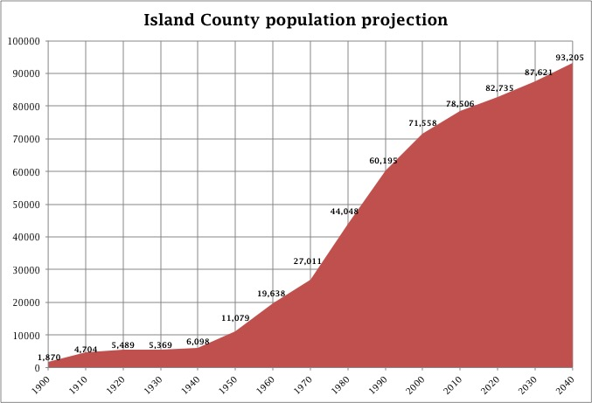
Island County demographic trends
WA OFM

Slide 39
2022 RCO SCORP Diary-Based Survey
WA RCO 2022 diary-based survey regions. Survey completed by 6,171 respondents.

Slide 40
2022 Island Counties recreation participation
WA RCO 2022 diary-based survey

Slide 41
Washington State/Island Counties recreation participation

Slide 42
2022 recreation frequencies
WA RCO 2022 diary-based survey

Slide 43
Island County 2050 recreation demand
Island County Chapter 7 Element Parks & Recreation Plan

Slide 44
Conservation, park, trail opportunities
Beach access Park acquisitions Trail linkage
2016 Island County PROS Plan

Slide 45
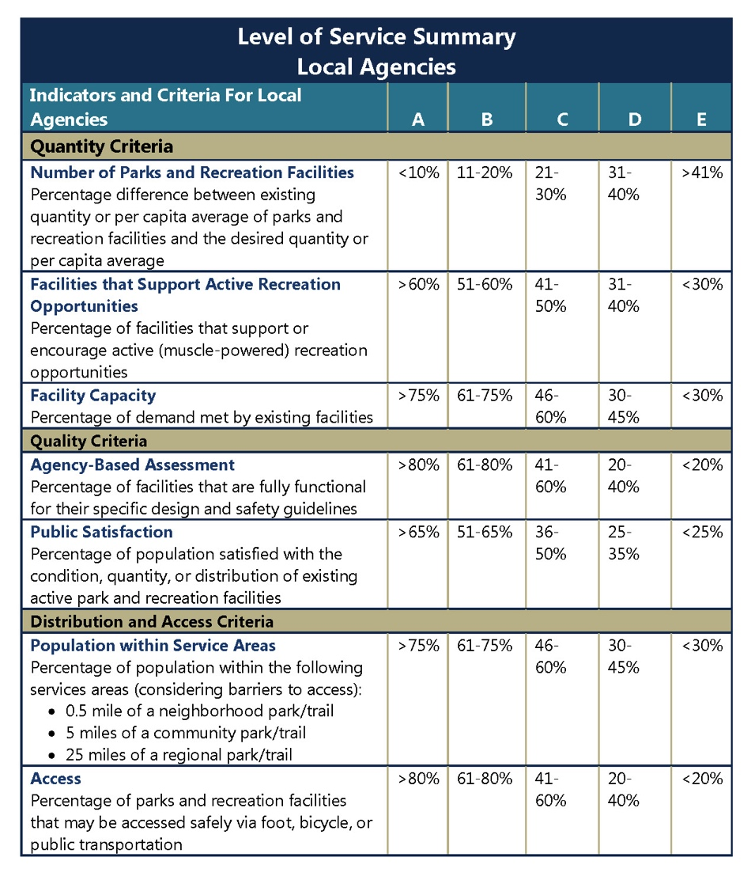
LOS methodologies
Quantitative
Ratios - NRPA
Investments - GMA
Participation/capacity – WA RCO
Qualitative
Functionality
Amenities
Social equity
Public satisfaction
Distributional
Gap analysis – simple distance
Gap analysis – GIS connectivity
NRPA Park Metric benchmarks
Staff per parkland/population
Expense per facility/program
Revenue per user/population

Slide 46
Current inventory
2016 Island County PROS Plan

Slide 47
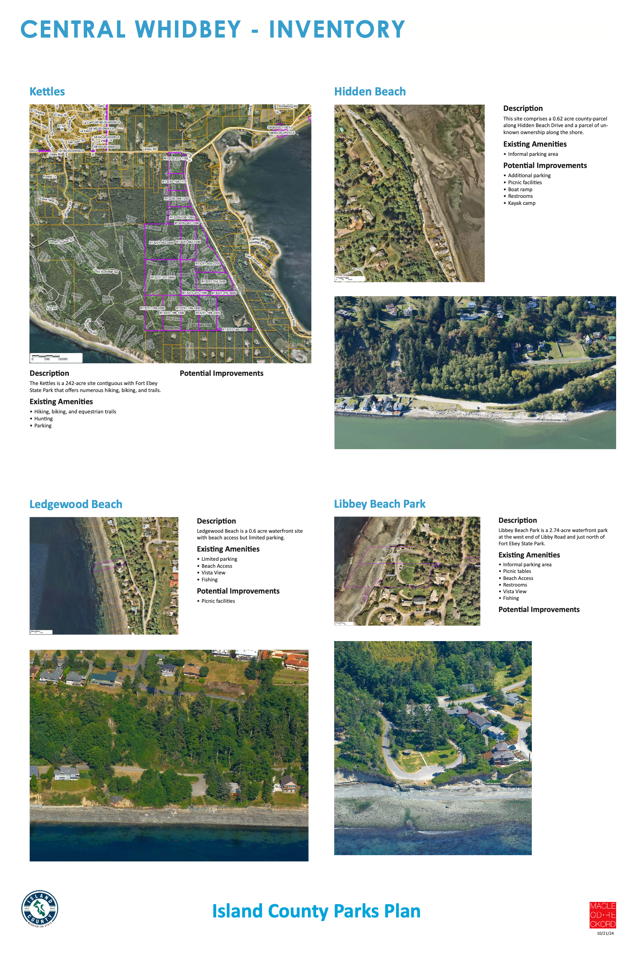
County park assessments – in progress

Slide 48
Project financing options – in progress
Revenues from alternative tools: Possible applications:
Conservation Futures | Acquire habitat
Retail Sales & Use Tax | Maintain parks, trails
Hotel/Motel Tax | Develop campgrounds, fair
Local Option Vehicle License/Fuel Taxes | Develop trails
REET 1, 2 | Develop parks, trails, facilities
RCO/ALEA/TEA21 Grants | Acquire/develop waterfront
Partnerships w/Schools/Leagues/Self-Help | Improve courts, fields, playgrounds
Volunteer – AmeriCorps | Maintain trails
Levy lid lift combining capital and O/M | Maintain/develop parks, trails
Lease-to-Own (LTO) 63:20 Nonprofit | Develop recreation facilities

Slide 49
Questions?

