Slide 1

Island County Food Industry Annual Meeting
Presentation March 10, 2025| Island County Food Safety Program

Slide 2

Island County food program staff
Shawn Morris, ND – Director Public Health
Taylor Lawson – Deputy Director Public Health
Heather Kortuem – Environmental Health Manager
Todd Appel, REHS/RS – Food Program Lead
Michelle McKee – Plan Review & Permitting Specialist
Program email – Foodsafety@islandcountywa.gov

Slide 3
Certified food protection manager course
Courses are offered 3-4 times per year
Next course:
Date: May 20th & 21st from 8:30 am – 3:30 pm
Address: Commissioner’s Hearing room, 1 7th street NW, B102 Coupeville
Cost: $150 (includes coursebook, instruction & examination)

Slide 4

Program updates/Information
New permitting software – we anticipate new permitting AND INSPECTION software online soon
It will allow online access to inspection reports & photos
It will email inspections as soon as they are completed
Temporary establishment permits
If you are operating outside of your normal licensed establishment, you must obtain a temporary establishment permit
To avoid late fees, must obtain a temporary establishment permit at least 14 days prior to event
These permits must be obtained at least 48 hours prior to the event
Food Vendor Guidelines available here:

Slide 5

Resources
Association of Food and Drug officials (AFDO)
Find important information about food safety laws, state regulations, guidance, and other resources in various languages.
Amharic
Arabic
Bengali
Bosnian
Cambodian
Cantonese
Chinese
Chuukese
English
Farsi
Filipino
French
German
Greek
Gujarati
Hmong
Haitian Creole
Hindi
Hungarian
Indonesian
Italian
Japanese
Khmer
Korean
Kurdish
Laotian
Latin
Maltese
Nepali
Oromo
Polish
Portuguese
Romanian
Serbian
Somali
Spanish
Tagolog
Tigrinya
Thai
Turkish
Telugu
Ukrainian
Urdu
Vietnamese
Access all these resources here:

Slide 6
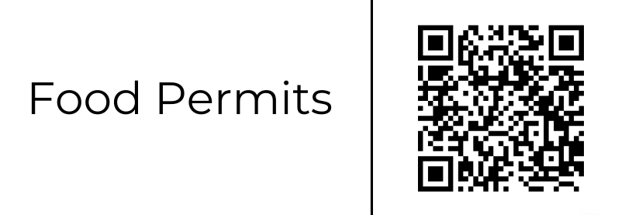
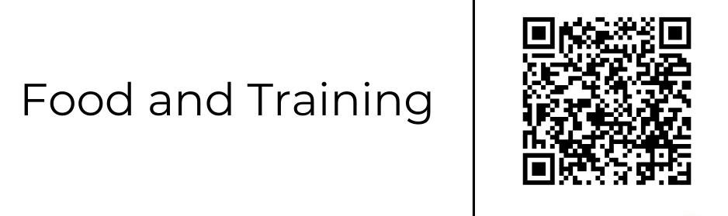
Resources
Washington State Retail Food Code
ISLAND COUNTY WEBSITE
Preparing for your Routine Inspection
Plan Review Guidance (Fixed Food and Mobile Food Establishments)
Sample Food Safety Managerial Plans
Sample Standard Operating Procedures
Sample Temperature Logs
Signs & Handouts

Slide 7
Imminent Health Hazards & Emergency Plans
“Imminent health hazard” means a significant threat or danger to health that is considered to exist when there is evidence sufficient to show that a product, practice, circumstance, or event creates a situation that requires immediate correction or cessation of operations to prevent injury based on fire, flood, extended interruption of electrical or water service, sewage backup, misuse of poisonous or toxic materials, onset of an apparent foodborne disease outbreak, gross insanitary occurrence or other circumstance that might endanger public health.

Slide 8
Emergency Plans
08455 Imminent health hazard--Ceasing operations and reporting (FDA Food Code 8-404.11)
(1) Except as specified in subsections (2) and (3) of this section, a PERMIT HOLDER shall immediately discontinue operations and notify the REGULATORY AUTHORITY if an IMMINENT HEALTH HAZARD might exist.
(2) A permit holder need not discontinue operations in an area of an establishment that is unaffected by the imminent health hazard.
(3) Considering the nature of the potential hazard involved and the complexity of the corrective action needed, the REGULATORY AUTHORITY may agree to continuing operations in the event of an extended interruption of electrical or water service if:
(a) A written emergency operating plan has been APPROVED;
(b) Immediate corrective action is taken to eliminate, prevent, or control any FOOD safety risk and IMMINENT HEALTH HAZARD associated with the electrical or water service interruption; and
(c) The REGULATORY AUTHORITY is informed upon implementation of the written emergency operating plan

Slide 9
Emergency Plans (Cont.)
An establishment must cease operations if an imminent health hazard exists such as:
No water
Sewer backup
Gross insanitary conditions
Ventilation system failure (unless an emergency plan is approved)
Power failure (unless an emergency plan is approved)

Slide 10
Emergency Plans (Cont.)
Procedures required during boil water advisory
Shut off:
Ice machines
Drinking fountains
Produce misters
Bottled water refill machines
Pop dispensers connected to water supply
Running water dipper wells
Coffee pots
Discard:
Ice
Food or beverages made with contaminated water
Use packaged ice from an approved source
Discontinue produce rinsing and use packaged pre-washed produce from an approved source.

Slide 11
Emergency Plans (Cont.)
Procedures required during boil water advisory
Handwashing:
Wash properly with soap and water
Use hand disinfectant and rinsing and drying hands
No bare hand contact with ready to eat foods – NO EXCEPTIONS!
Dishwashing:
Follow normal procedures or use single-service tableware and utensils.
Mechanical dishwasher with high temperature or chemical sanitizer – VERIFY CORRECT OPERATIONS!
Reduce menu to limit potential risk
Post signs or copies of the Health advisory
Develop a plan to notify and educate employees about emergency procedures

Slide 12
Emergency Plans (Cont.)
Power outage
Keep track of the time the outage begins
Stop using gas or solid fuel cooking and heating equipment if the exhaust hood and make-up air systems stop working
Throw away any foods that are in the process of being cooked but have not yet reached their final cooking temperature
Do not use portable generators indoors!
Stop preparing food if:
Food cannot be kept at safe temperatures
There is no hot water
There is not enough water pressure
You cannot wash, rinse and sanitize utensils properly
There is not enough light for employees to work safely.

Slide 13
Emergency Plans (Cont.)
Power outage
Actions that can keep food safe for several hours:
Keep refrigerator and freezer doors closed as much as possible
If practical, group packages of cold food together. keep raw meats away from other kinds of food.
Cover any open display refrigerators and freezers, especially vertical displays.
Surround food with ice (Caution- If you use dry ice to cool food, it may cause an unsafe build up of carbon dioxide in enclosed spaces)
Don’t put hot foods in refrigerators or freezers
Use canned chafing dish fuel under food on electric steam tables to help keep TCS foods over 135F.

Slide 14
Emergency Plans (Cont.)
Power outage – After power is restored
Check the internal temperatures of all hot and cold TCS foods
If cold foods were grouped together to keep them cold, space them out again so they will cool more quickly
Decide to either keep or throw away TCS food as shown in the tables below.
Hours power is out | 45F or below | 46F to 50F | 51F or above
0-2 | Safe to Sell | Safe to Sell- Immediately cool to 41F | Safe to Sell- Immediately cool to 41F
2-4 | Safe to sell | Safe to Sell- Immediately cool to 41F | Unsafe, discard
More than 4 | Safe to sell | Unsafe, discard | Unsafe, discard
Cold Food
Hours power is out | 130F or above | 129F or below
0-2 | OK | Safe to sell- Immediately heat to 165F and hold at 135F or cool to 41F
2-4 | Safe to sell- Immediately heat to 165F and hold at 135F or cool to 41F | Unsafe, Discard
More than 4 | Safe to sell- Immediately heat to 165F and hold at 135F or cool to 41F | Unsafe, Discard
Hot Food

Slide 15
Food Establishment Categories
Current Categories | Proposed Categories | Definition / Reasoning
Risk 1 Establishments by Seating | Same | Establishments that sell or store only prepackaged goods OR Establishments that serve non-TCS goods OR Establishments that serve coffee drinks with TCS ingredients OR Establishments serving non-TCS beverages with ice and/or are ware washing.
Risk 2 Establishments by Seating | Same | Establishments that serve, sell, prepare, or stores TCS foods (no cooling) OR Establishments that are preparing blender drinks w/TCS ingredients OR Establishments that are serving ice cream (soft serve or scooped).
Risk 3 Establishments by Seating | Same | Food establishments with complex preparation including cooking, cooling, and/or reheating of prepared foods OR Food establishments that prepare foods using a specialized process. Food establishments that prepare foods more than 24 hours in advance of service.
Grocery 1-4 checkout stands | Grocery, 1-2 checkout stands

Slide 16
Food Establishment Categories
Current Categories | Proposed Categories | Definition / Reasoning
Grocery 5 or more checkout stands | Grocery, 3-4 checkout stands Grocery, 5+ checkout stands
Bakery | Risk 1 or 2 Establishment by seating
Bed & Breakfast | Bed & Breakfast | 3+ rooms in an owner-occupied home serving only breakfast to guests (Risk 1, 2 or 3)
Caterers & Cottage Industries | Categorized by Risk Category | Caterers should be charged by their risk category with no seating
Convenience Store w/ Prepackaged foods | Grocery by checkout stand # | Convenience store is just a small grocery.
Convenience Store w/ Food service | Categorized by Risk Category | Convenience store with food should be charged by their risk category.
Espresso Stand | Categorized by Risk | Espresso Stands should be categories by their risk category
Institutional Kitchen- Full | School Kitchen

Slide 17
Food Establishment Categories (Cont.)
Current Categories | Proposed Categories | Definitions / Reasoning
Institutional Kitchen-Satellite | School Kitchen
Mobile Cart | Categorized by Risk | Mobile units should be categorized by their risk category
Non- Profit Permanent | Categorized by Risk with non-profit discount | Non-Profits should be licensed appropriately by their risk category and then a discount applied
Taverns (without Food) | Categorized by Risk | They should be categorized by risk
Wineries, Breweries, Distilleries | Categorized by Risk | They should be categorized by risk
Vending Machine | Micro Market | An unmanned retail space where individuals can purchase TCS food & beverages from an approved source.
Plan Review | Broken into several plan review categories and charged a flat rate, for set # of hours) | Will allow better budgeting for establishments.

Slide 18
Food Establishment Categories (Cont.)
New Categories | Definitions / Reasoning
Special Processes Permit (in addition to risk category) | Special processes (HACCP, Sushi, Unattended Cooking, Sous Vide, Vacuum Package & Fermentation) require additional inspections.
Catering Endorsement (in addition to risk category) | For licensed FSE, if they are catering off-site, they would need additional inspections.
Commissary Endorsement (in addition to risk category) | For licensed FSE that is renting their kitchen to another establishment, requires additional time for inspection of space.
Produce processing (in addition to checkout stands in grocery) | For additional produce processing department in grocery store
Commissary Kitchen | For a stand alone kitchen that is acting as a commissary, previously billed as an institutional kitchen.
Temp event permit-Recurring events | Operating not more than three days a week at a fixed location, with a fixed menu, in conjunction with an APPROVED, recurring, organized event, such as a farmers market
Temp event permit- Single event | Operating at a fixed location, with a fixed menu, for not more than twenty-one consecutive days in conjunction with a single event or celebration, such as a fair or festival
Umbrella Permit | For judged cooking events- will cover 3 hours of inspections, up to 10 participants

Slide 19
Approved equipment
04272 Acceptability--Food equipment, certification and classification (FDA Food Code 4-205.10).
FOOD EQUIPMENT that is certified or classified for sanitation in conformance with a recognized American National Standards Institute (ANSI) - Accredited certification program is deemed to comply with Subparts A and B of this part.

Slide 20
Approved equipment (Cont.)
Sample Sanitation Certification Marks The below agencies are accredited by ANSI as a Certification Body (ISO/IEC 17065)

Slide 21
Approved equipment (Cont.)
Vevor equipment
This company offers only very limited NSF approved equipment
Hand sink
Equipment stand
Stainless steel work table
Stainless steel shelf
Company advertises “commercial equipment” but it does not meet the
Requirements of the Washington State Retail Food Code. Please do not
Purchase ice machines, refrigerated units, soft serve machines, etc. from this
Company as the equipment is not approved and cannot be used in food service
Establishments.

Slide 22
IslandCountyWa.gov
Questions?

